Slide 1

Spot That Fire V2.0

Slide 2
INTRODUCTION

Slide 3
Forests and crops are often treated with flame-retardant chemicals and pesticides.
Smoke particles contain acids and gases very dangerous
These particles can affect both respiratory system and skin
It is difficult for civils to find scape routes

Slide 5
Present problems
Small fires are not inmediatelly detected by NASA satellite
not inmediatelly
takes time
Once they are reported, it takes time to coordinate
risking their lives
Civils can not help but risking their lives
Smoke affects visibility
visibility

Slide 6
METODOLOGHY

Slide 7
A
Diagrams and tasks organisation
B
Data gathering and data analysis

Slide 8
Mobile Application and CNN
C
Data gathering and data analysis
B
A
Diagrams and tasks organisation

Slide 9
Mobile Application and CNN
C
Data gathering and data analysis
B
A
Diagrams and tasks organisation
Fires predictive algorithm
D

Slide 10
Implementation
E
Fires predictive algorithm
D
Mobile Application and CNN
C
Data gathering and data analysis
B
A
Diagrams and tasks organisation

Slide 11
Implementation
E
Fires prediction algorithm
D
Mobile Application and CNN
C
Data gathering and data analysis
B
A
Diagrams and tasks organisation

Slide 12
A
Diagrams and tasks organisation

Slide 13
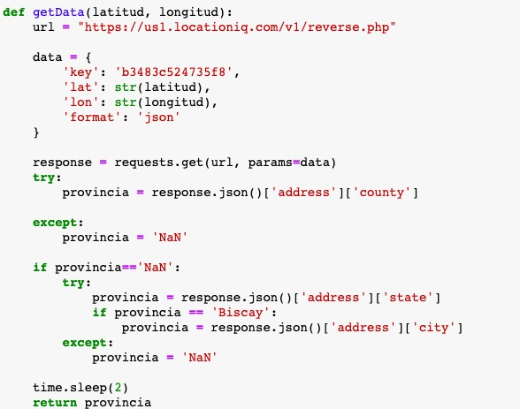
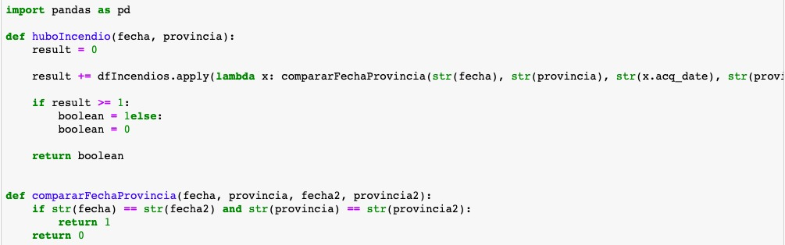
B
Data gathering and data analysis

Slide 14
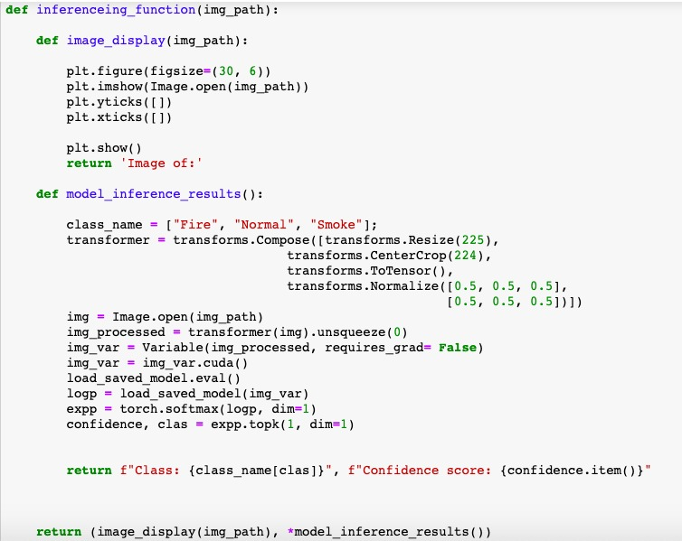
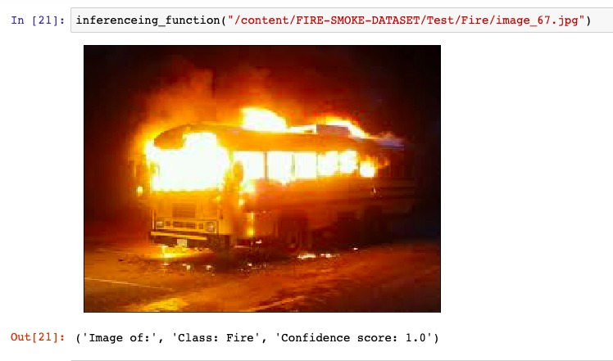
C
Mobile application and CNN

Slide 15
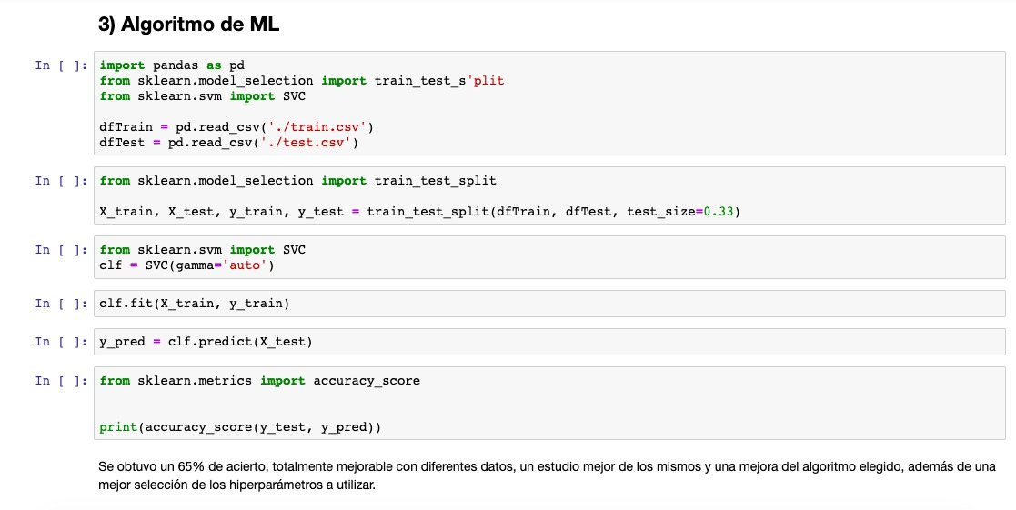
D
Fires prediction algorithm

Slide 16
E
Implementation

Slide 17

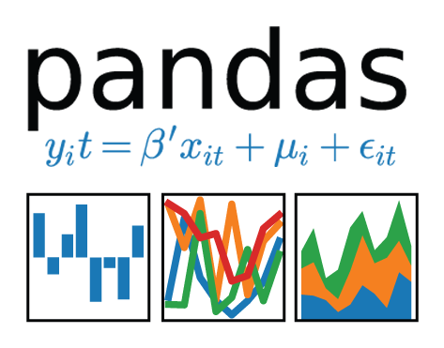




Tecnologies employed

Slide 18
Data sources
MODIS 13
MODIS 16
VIIRS

Slide 19
HOW DOES IT WORKS?

Slide 20











Server
Server
Client
FIREHAZARD
- - - - - - - - - - - - - - - - - - - - - - - - - - -
- - - - - - - - - - - - - -

Slide 21
Advantages of this app
Services are awared inmediatelly once fires are reported
inmediatelly
few resources
few resources
It needs few resources and they are cheap
cheap
without risking
Civils can help without risking their lives
Alerts allow civils to reach safety
reach safety

Slide 22
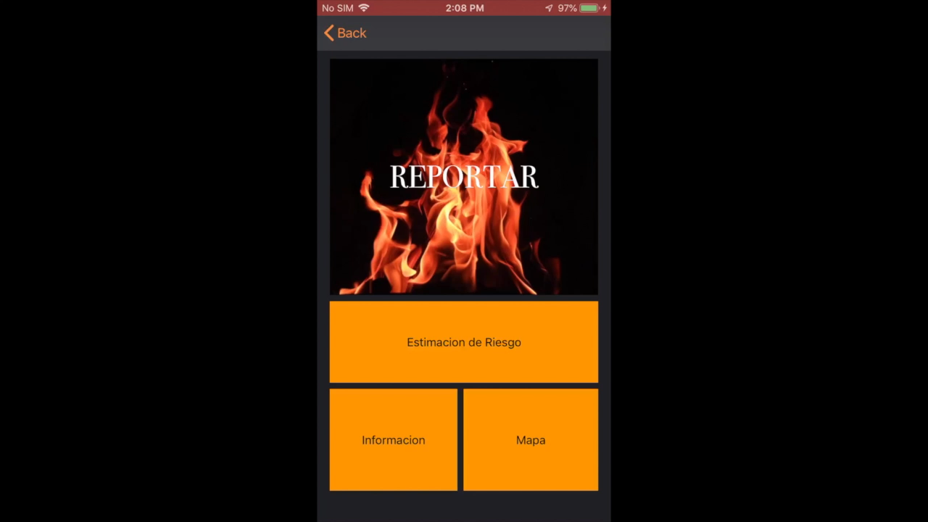
DEMO

Slide 23
FUTURE DEVELOPEMENT

Slide 24
Scape routes
UX improvement
Augmented reality
Find better data
Algorithm improvement

Slide 25
Spot That Fire V2.0

